Slide 1
The Trifold
*The trifold is to be created and assembled at home by the student.
Items that need to be included are:
In the middle of the trifold (the large section in the middle)
name of the patriot as a title
either paint, draw (and color) a background that pertains to the Patriot (such as a large flag for Betsy Ross, a battle scene of the Serapis and the Bonhomme Richard for John Paul Jones, or a swamp for Francis Marion)
The following should be put on the two outside flaps:
A portrait of the patriot – this will be done in Art class.
Maps if applicable
Pictures of events (hand drawn)
Quotations if applicable
5 important facts about the patriot
Materials Needed:
One large size tri-fold poster presentation report board- size: 36 in x 48 in. (This can be purchased at Office Max, Office Depot, Wal-Mart or Hobby Lobby.

Slide 2
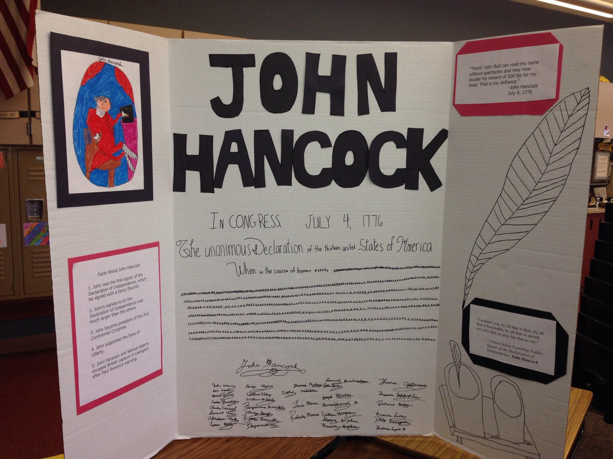

Slide 3
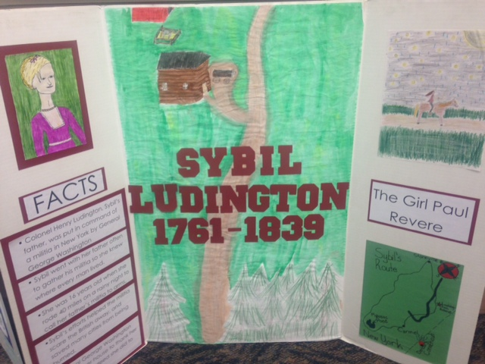

Slide 4
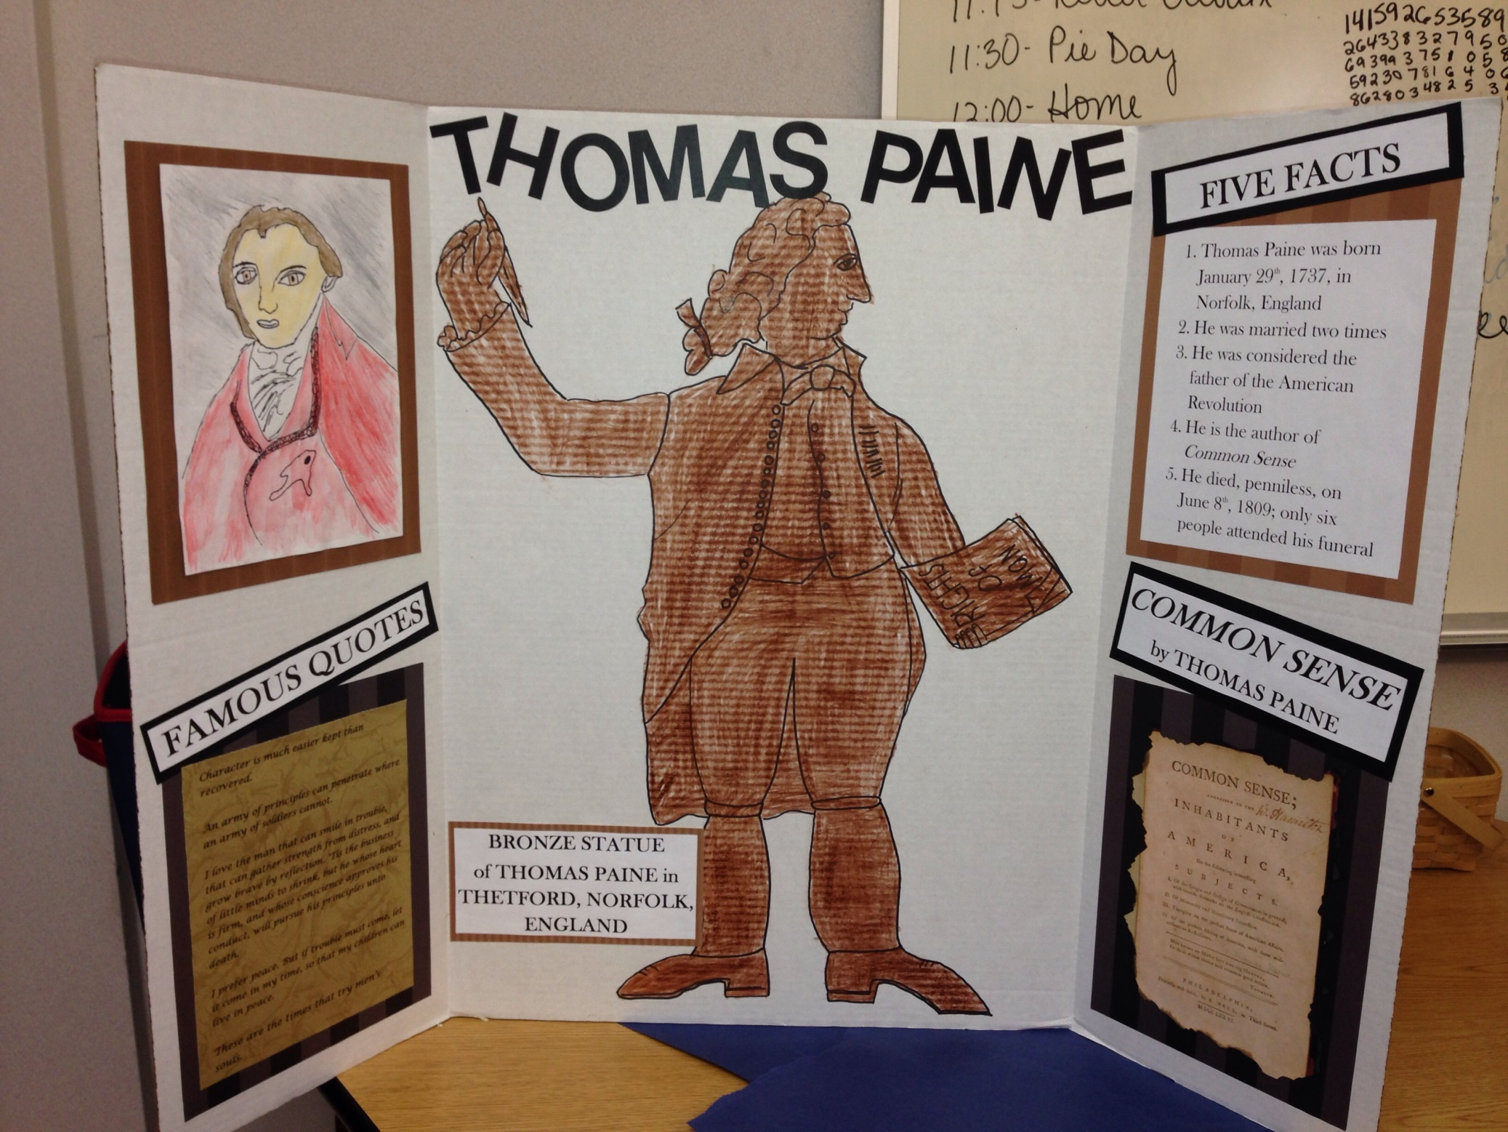

Slide 5
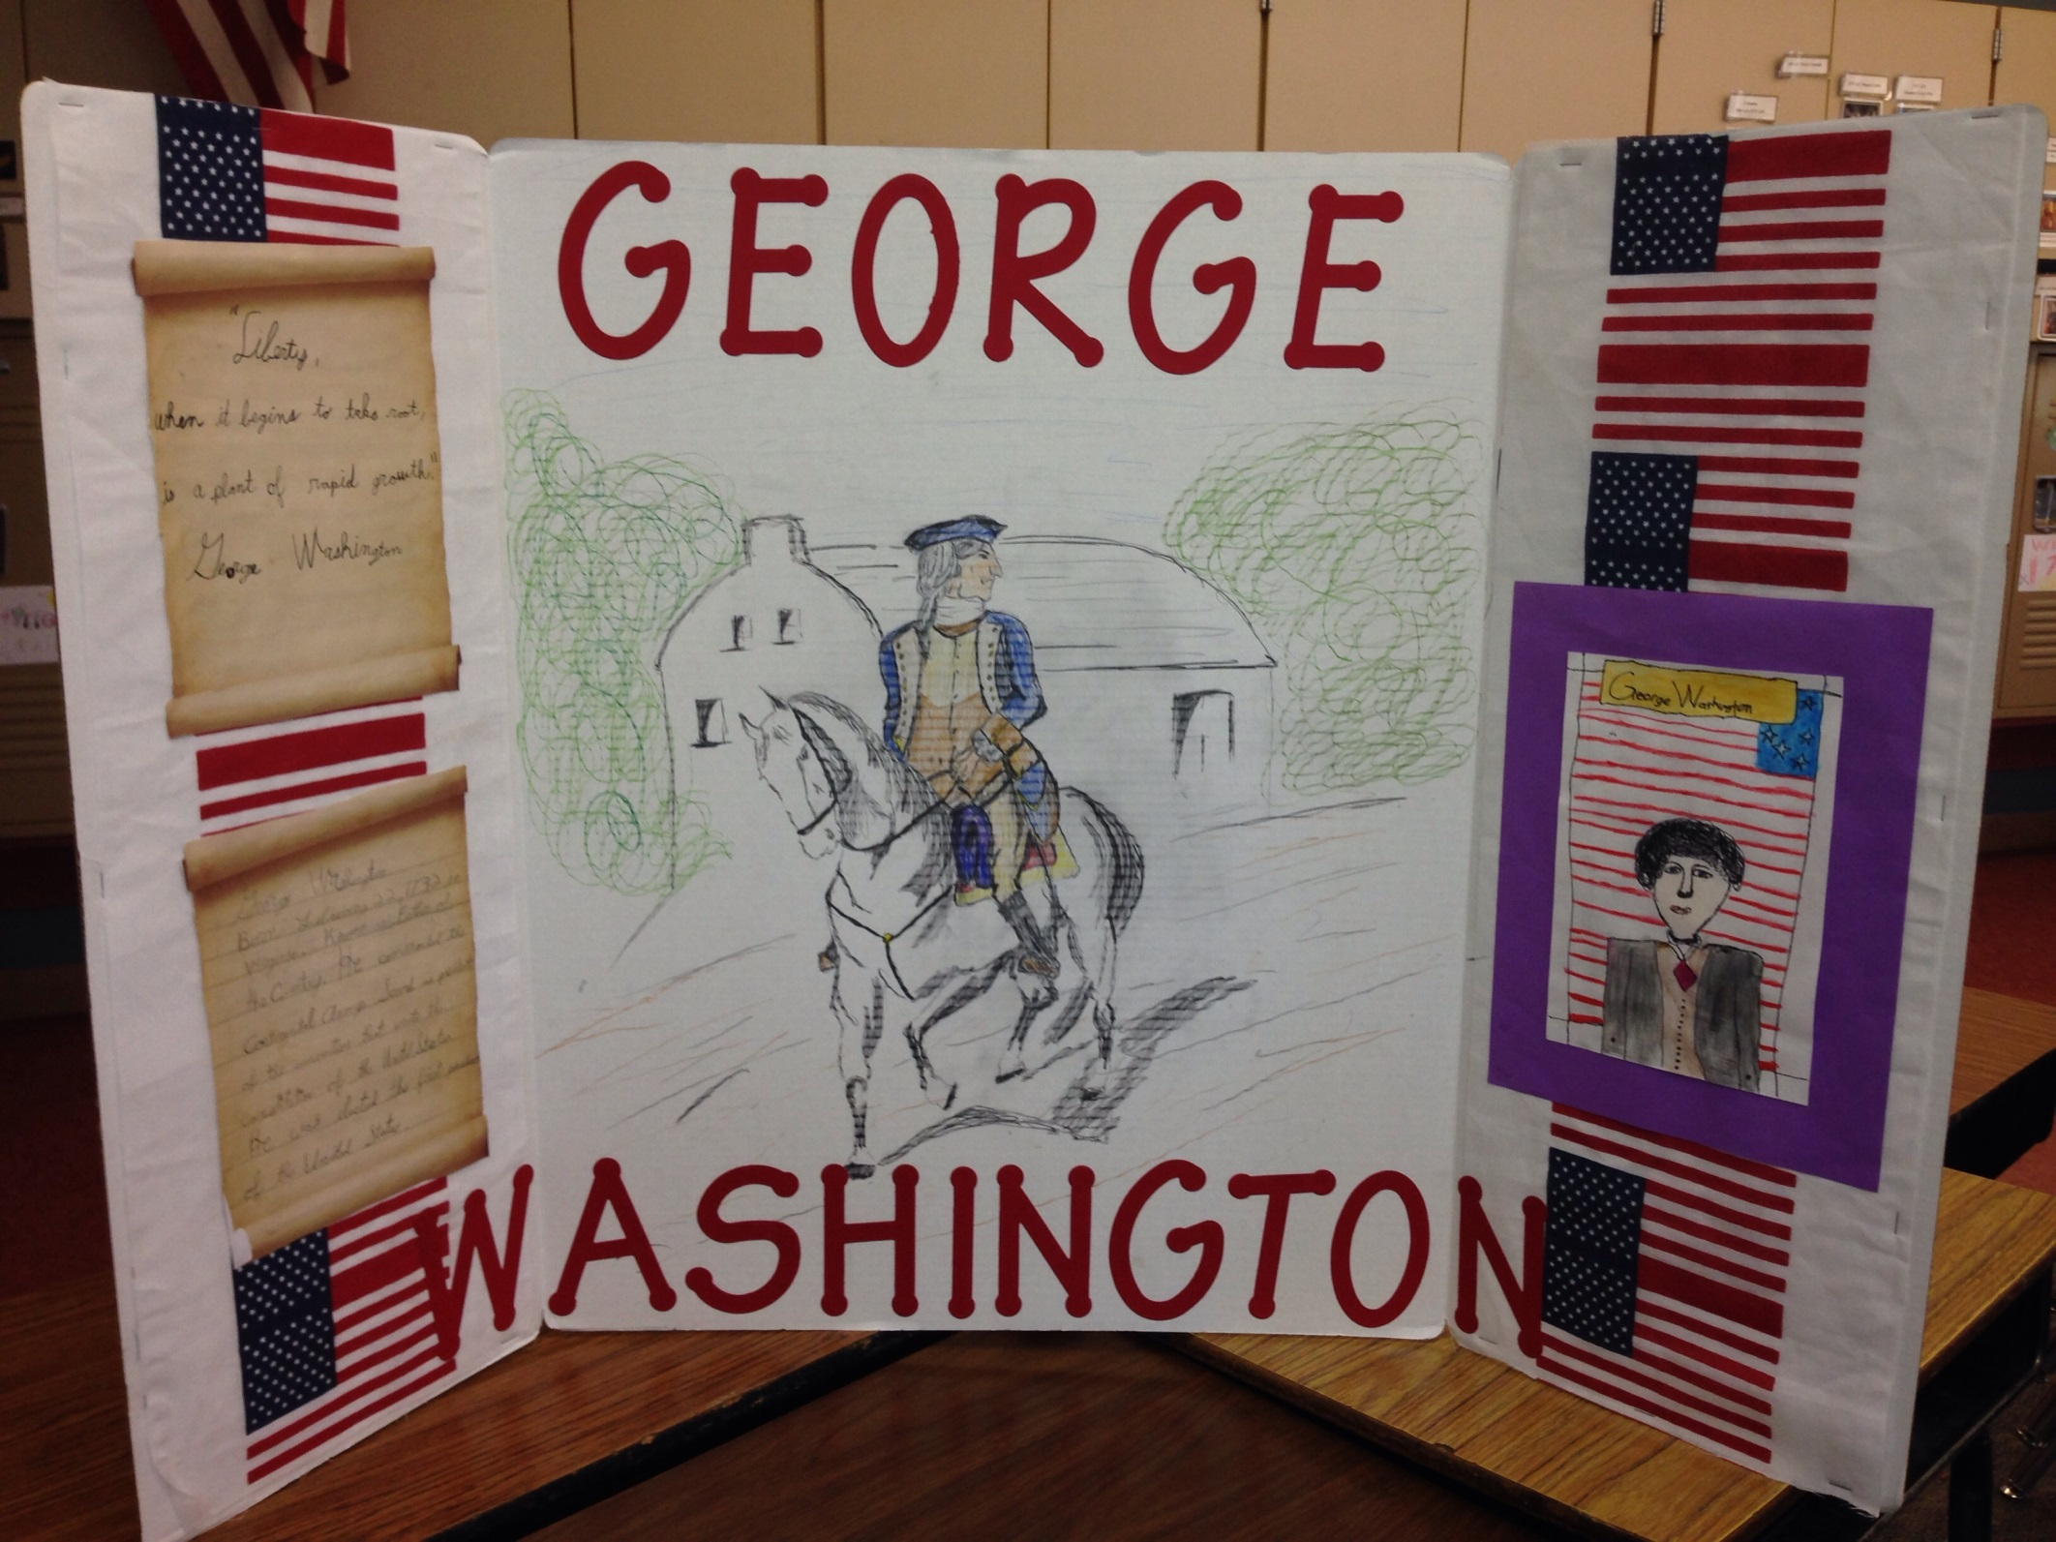

Slide 6
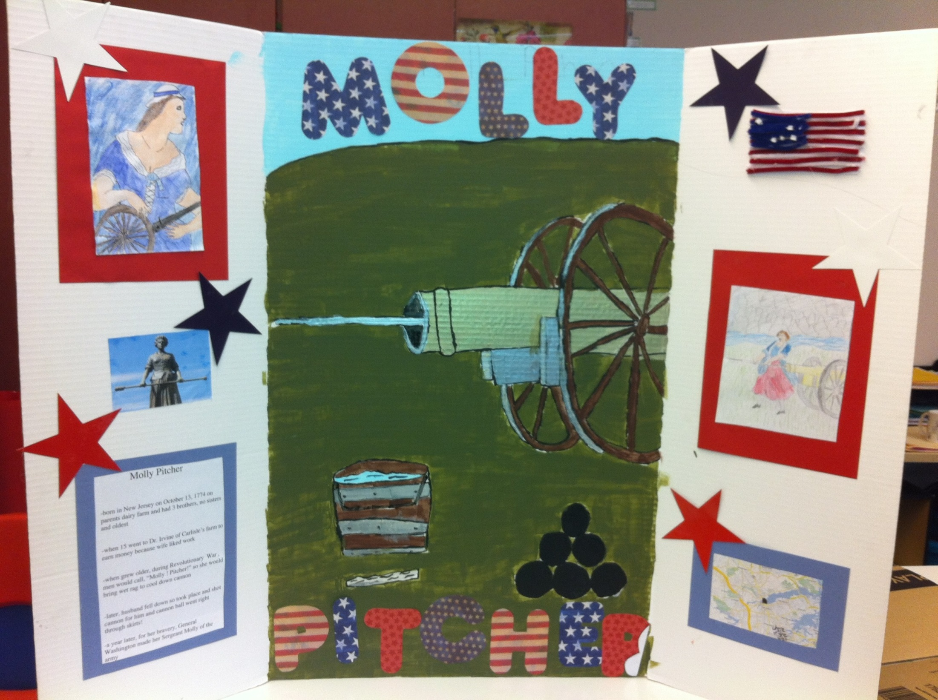

Slide 7
